Slide 1
CHAPTER 23
Hormonal Regulation and Integration of Mammalian Metabolism
Xiao-Wei Chen, Ph.D.
xiaowei_chen@pku.edu.cn

Slide 2
Outline of today’s discussion
Fasted vs fed
Lean vs obese
Healthy vs diabetic
Molecular genetics of metabolism

Slide 3
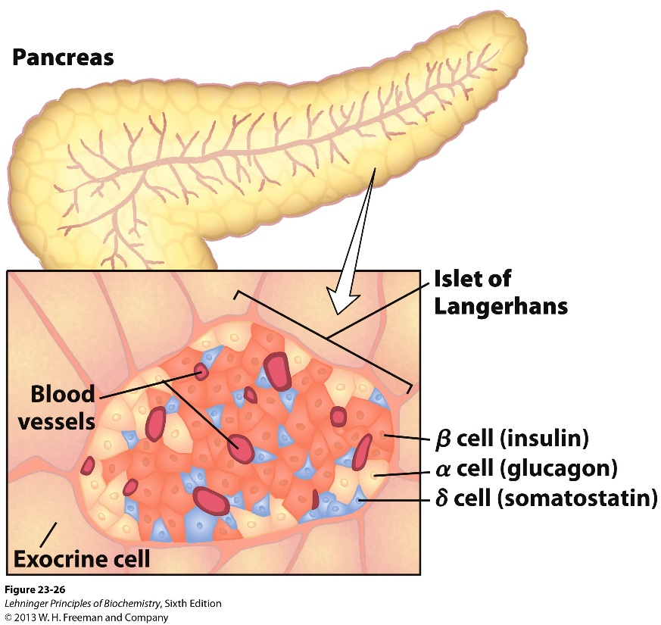
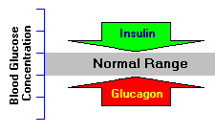
Glucose homeostasis regulated by insulin and glucagon

Slide 4
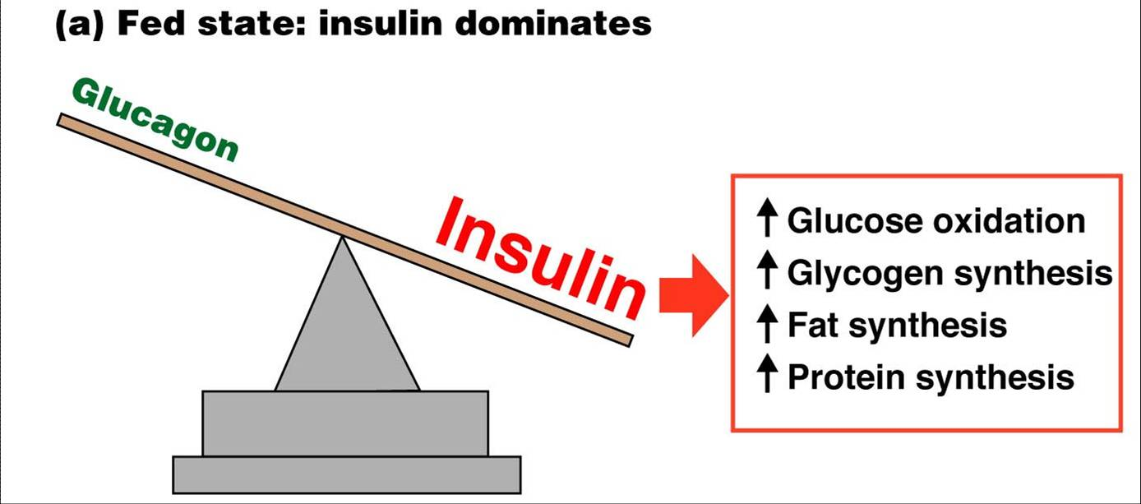
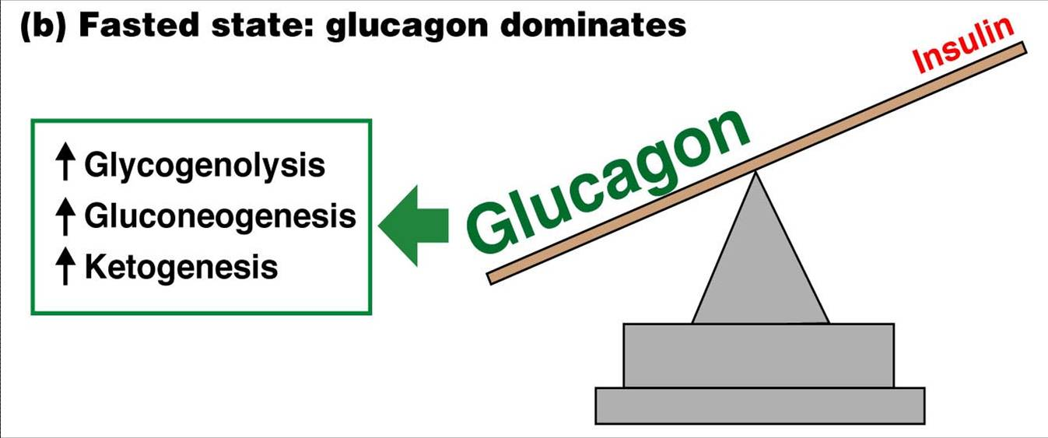
Insulin and glucagon in fed vs fasted states

Slide 5
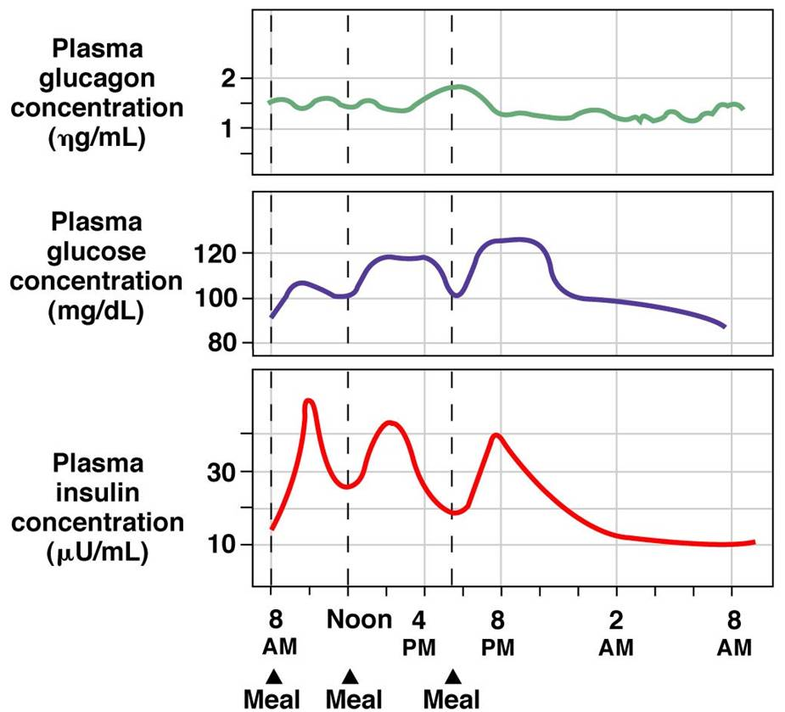
Insulin and glucagon in fed vs fasted states

Slide 6
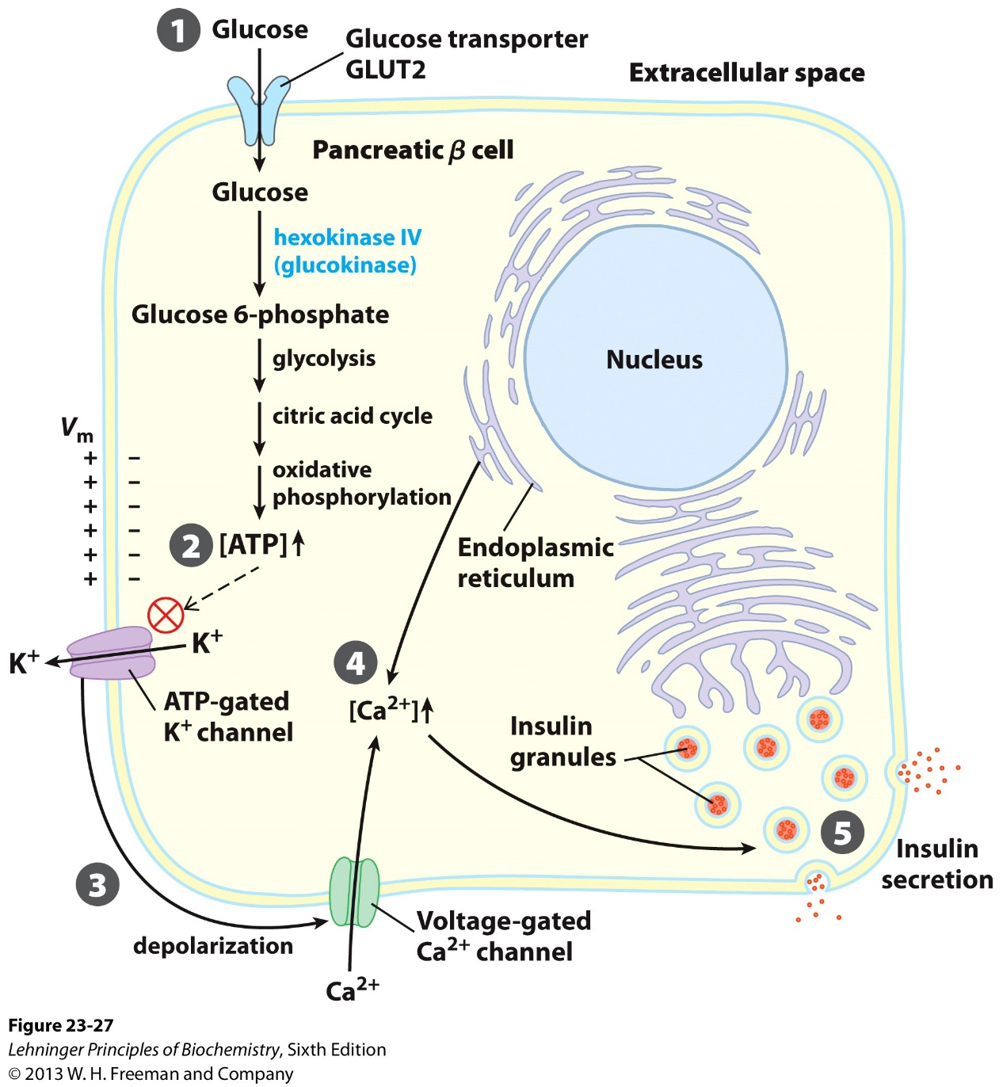
Glucose-induced insulin release from the pancreas
Glucose sensor: Glut2
Glucose breakdown and ATP production
ATP-gated potassium channel closes
Voltage-gated calcium channel opens, triggering calcium release from the ER
Insulin granule releases

Slide 7
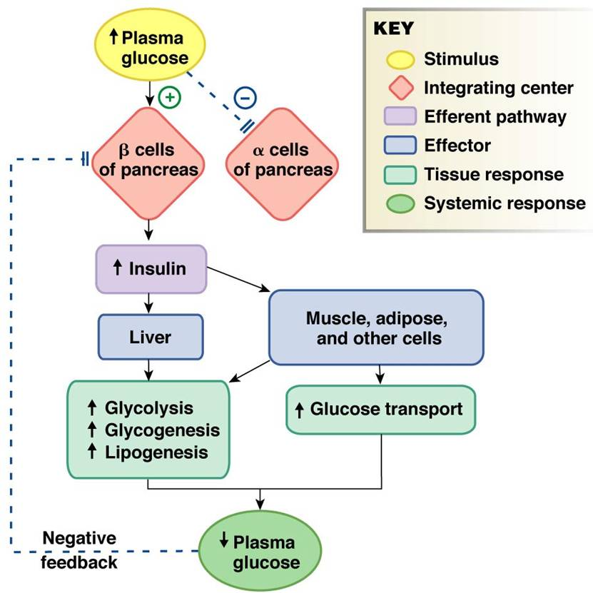
Metabolic actions of insulin

Slide 8
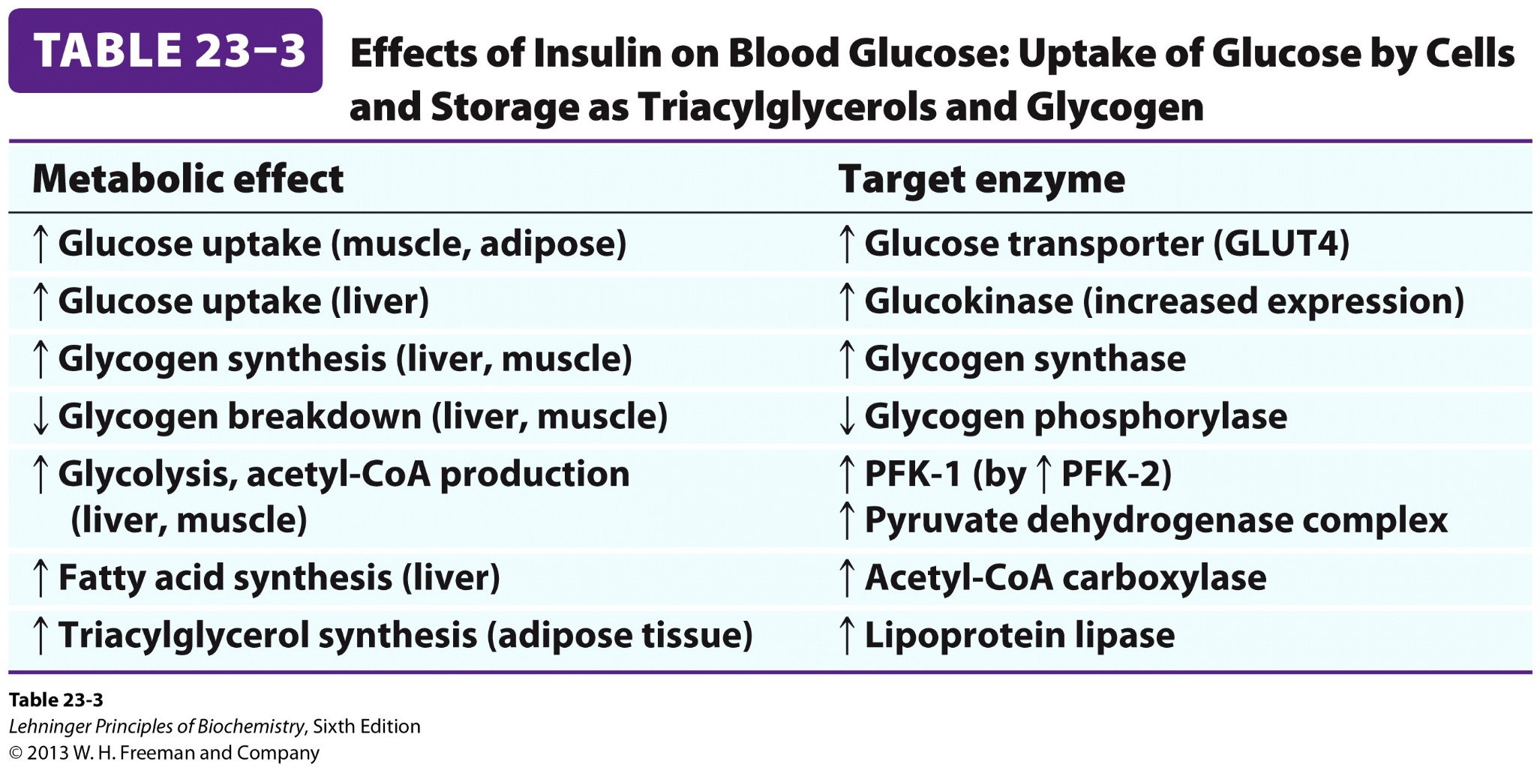
Metabolic actions of insulin: molecular targets

Slide 9
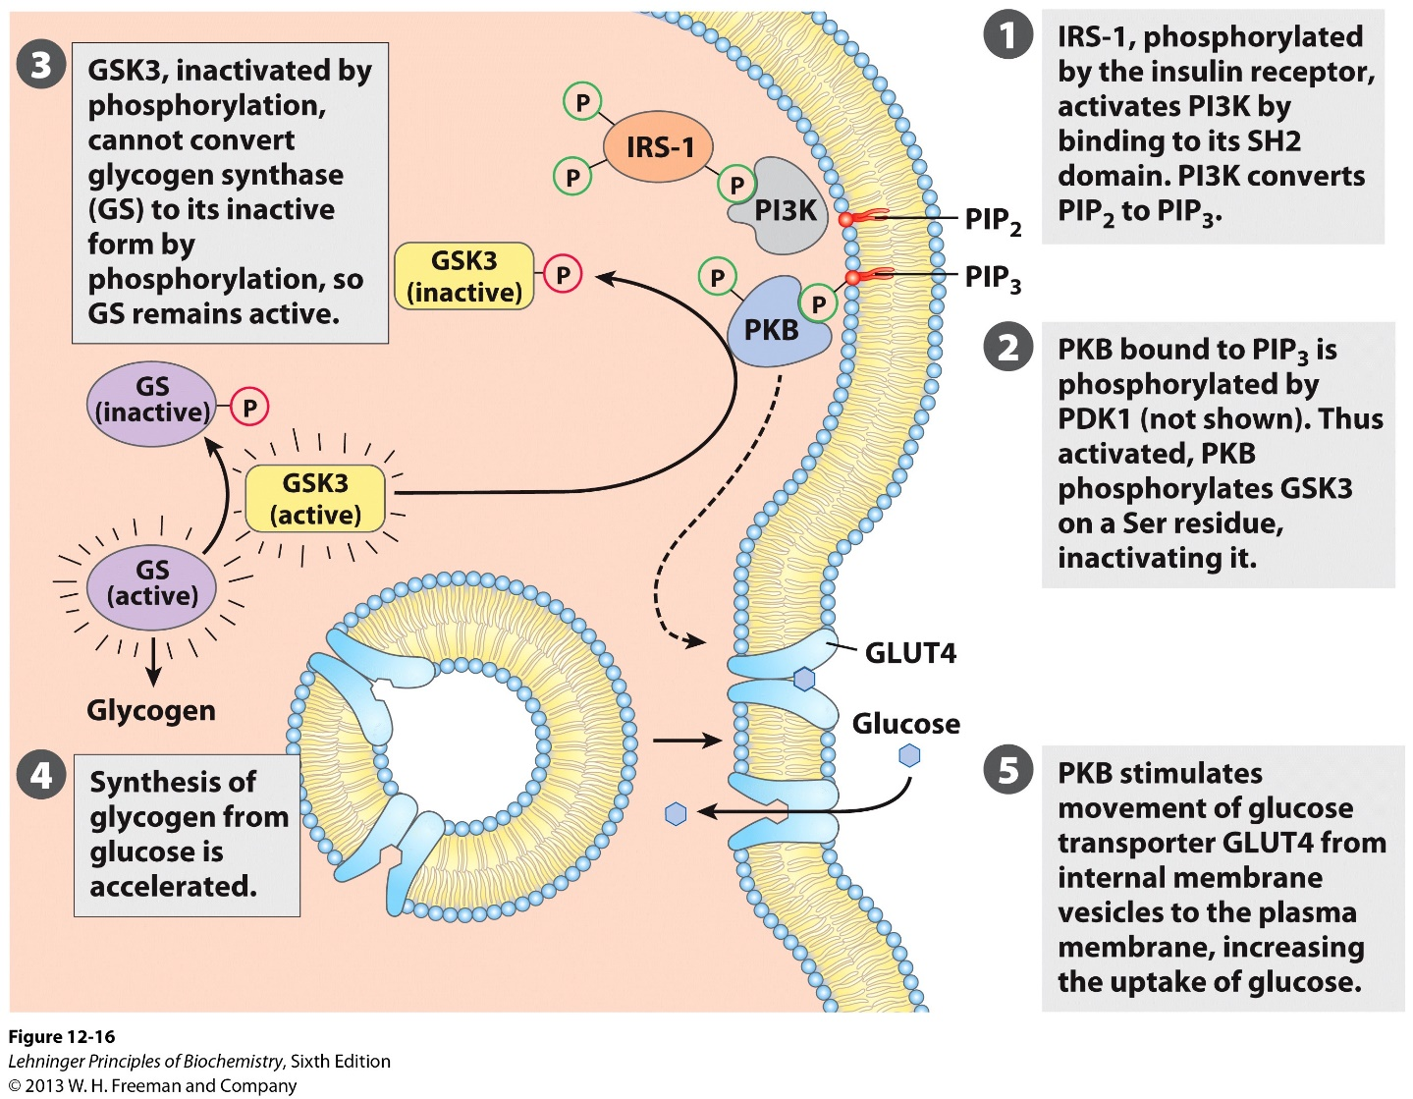
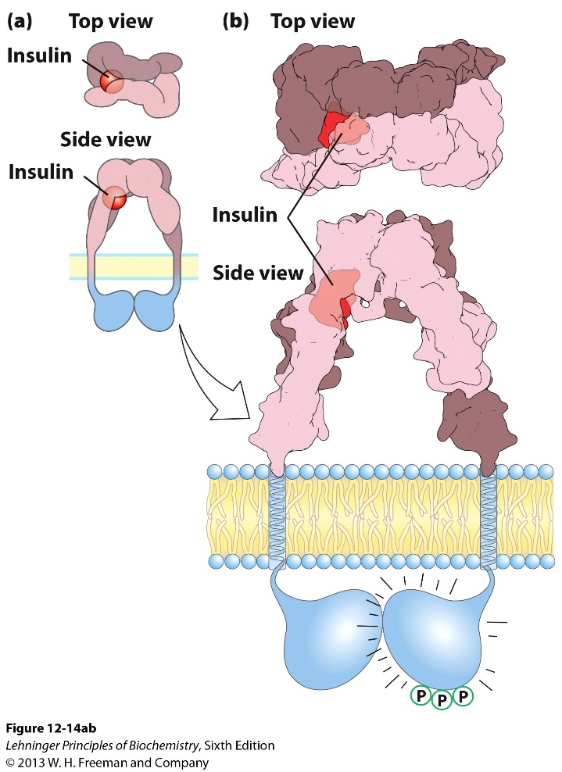
Insulin signaling and regulation of glycogen synthase

Slide 10
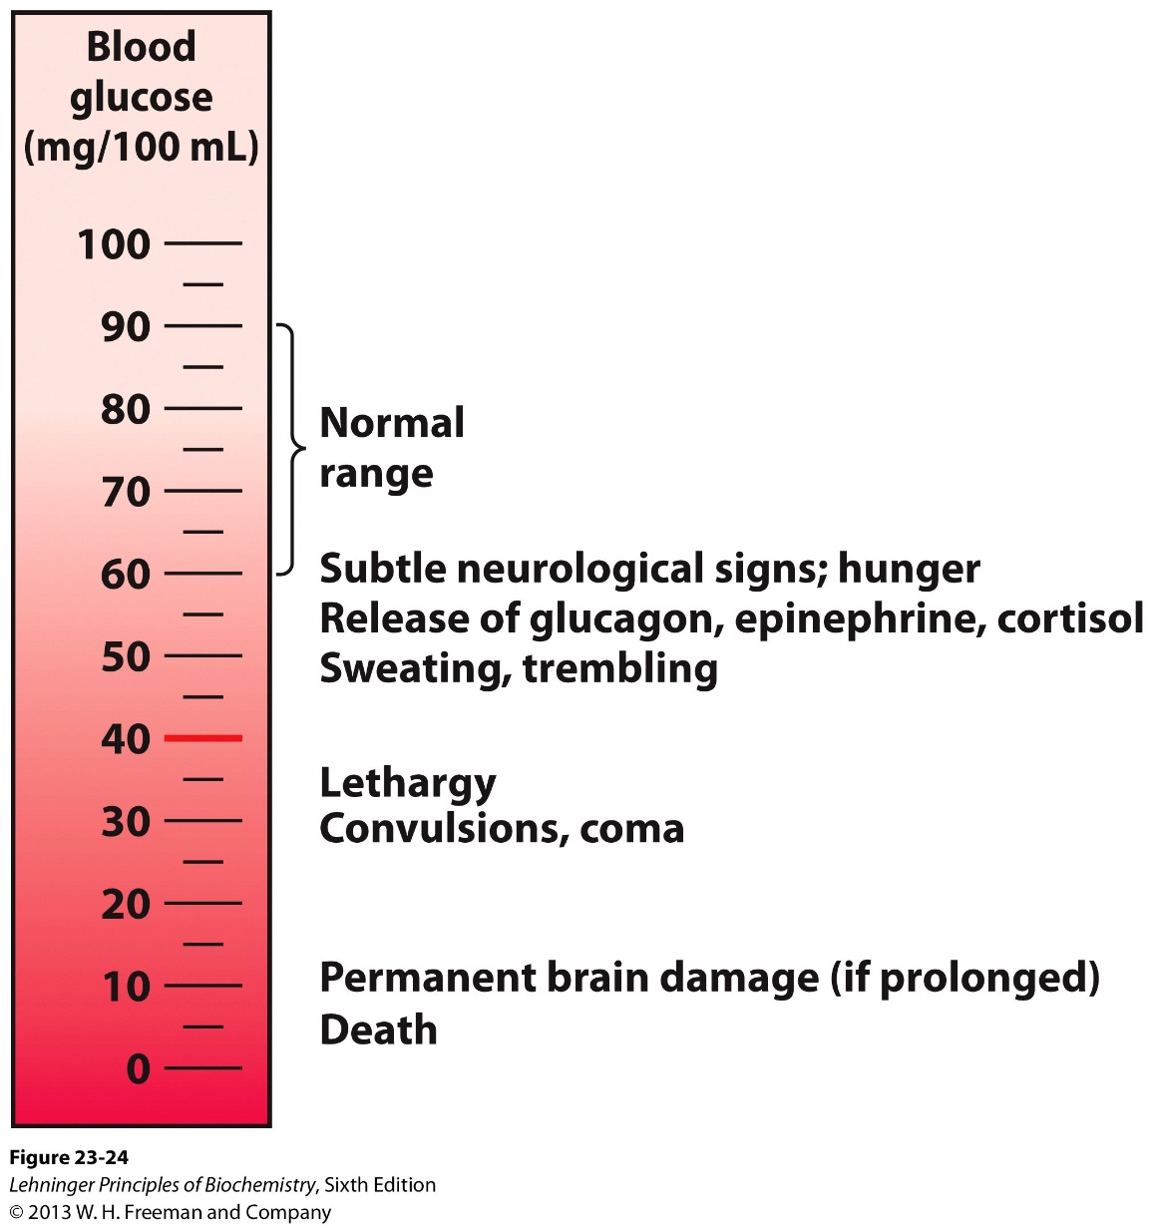
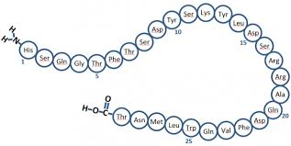

Blood glucose has to be maintained at certain level

Slide 11
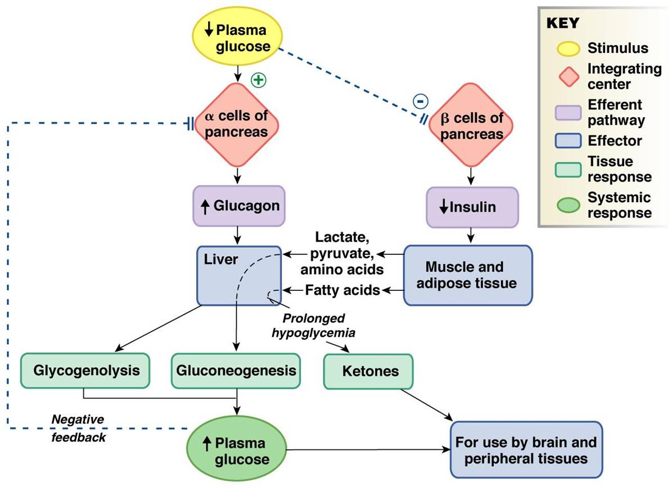
Metabolic actions of glucagon

Slide 12
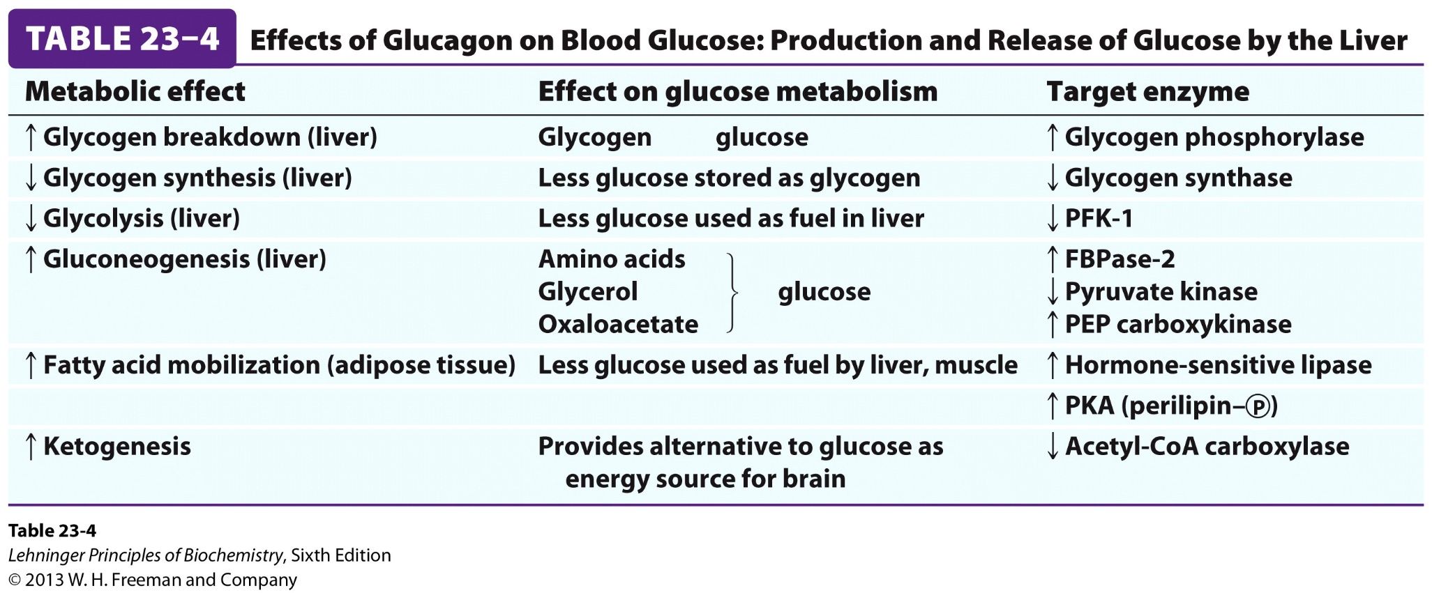
Metabolic actions of glucagon

Slide 13
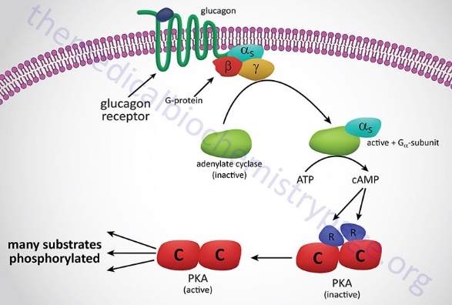
Molecular actions of glucagon

Slide 14
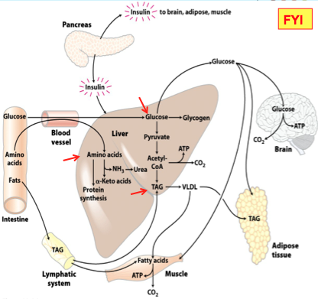
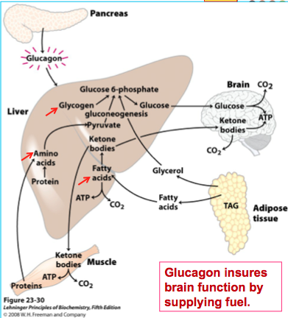
Liver in the well-fed (lipogenic) and fasted (glucogenic) states
Well-fed
Fasted

Slide 15
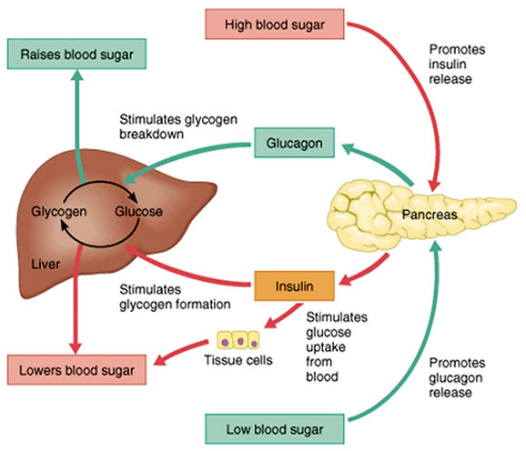

Metabolic regulations aim to maintain homeostasis (via feedback mechanism)
Catabolic
Anabolic
Increase blood lipids

Slide 16
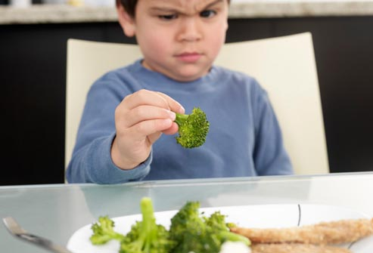
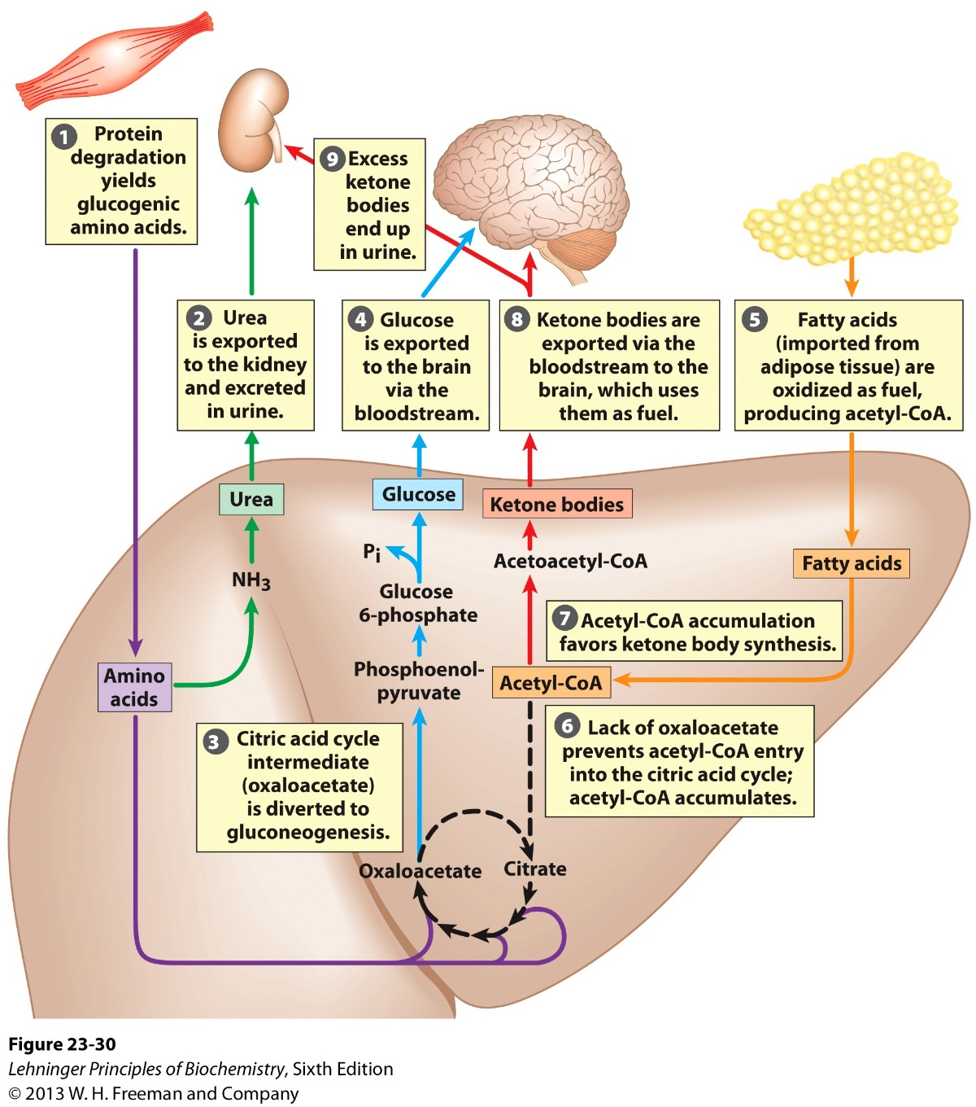
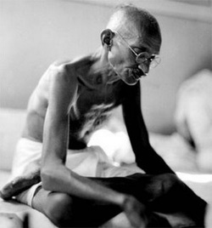
Metabolic effects of long term starvation

Slide 17
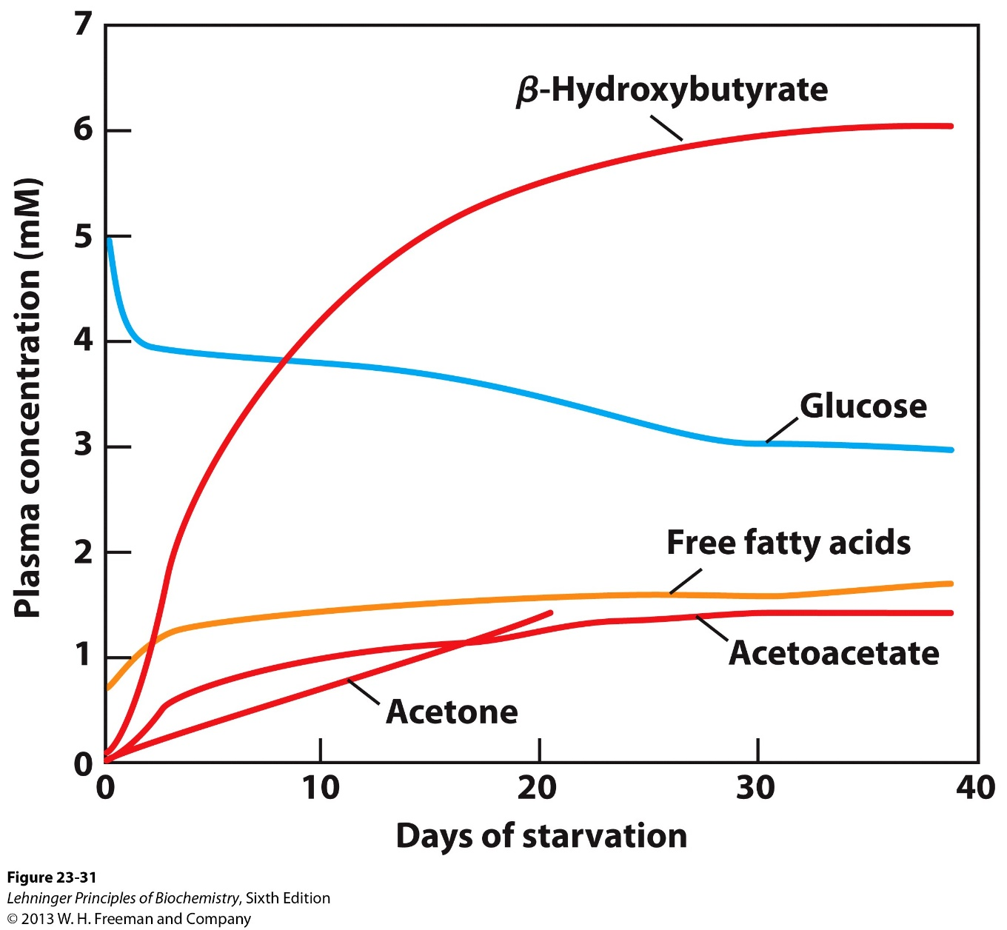
Metabolic effects of long term starvation

Slide 18
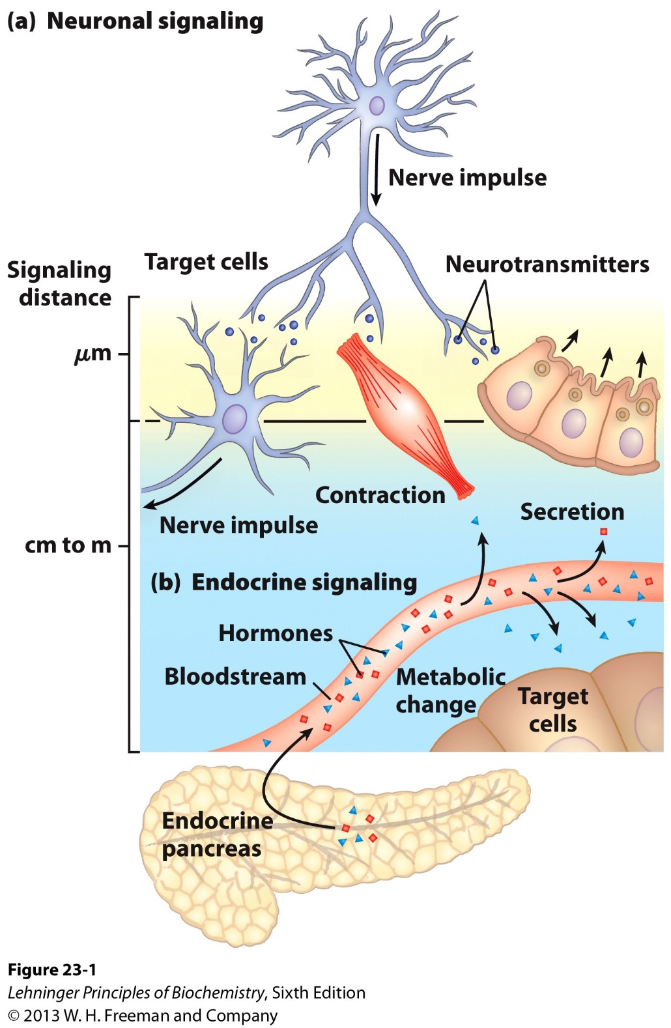
Neuroendocrine Regulation of Metabolism
Neuronal signal
Short distance, faster
Endocrine signal
Long distance, slower

Slide 19
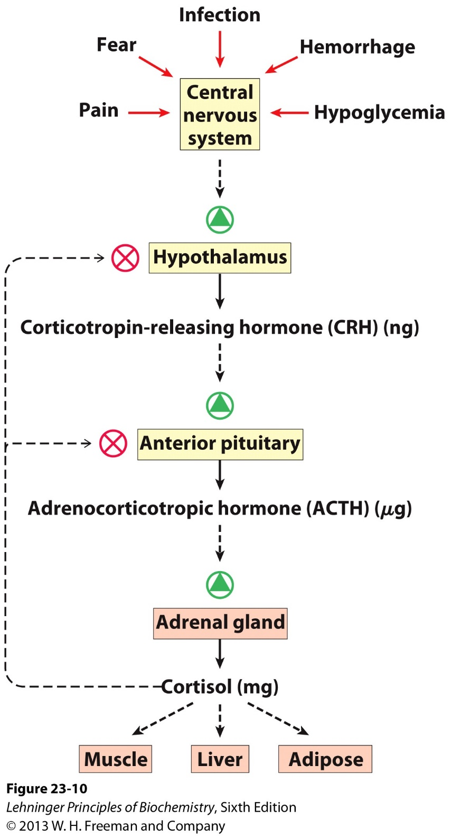
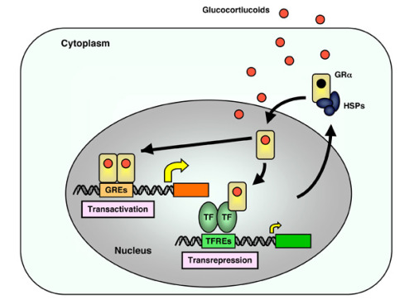
Metabolic effects of cortisol, the stress hormone

Slide 20
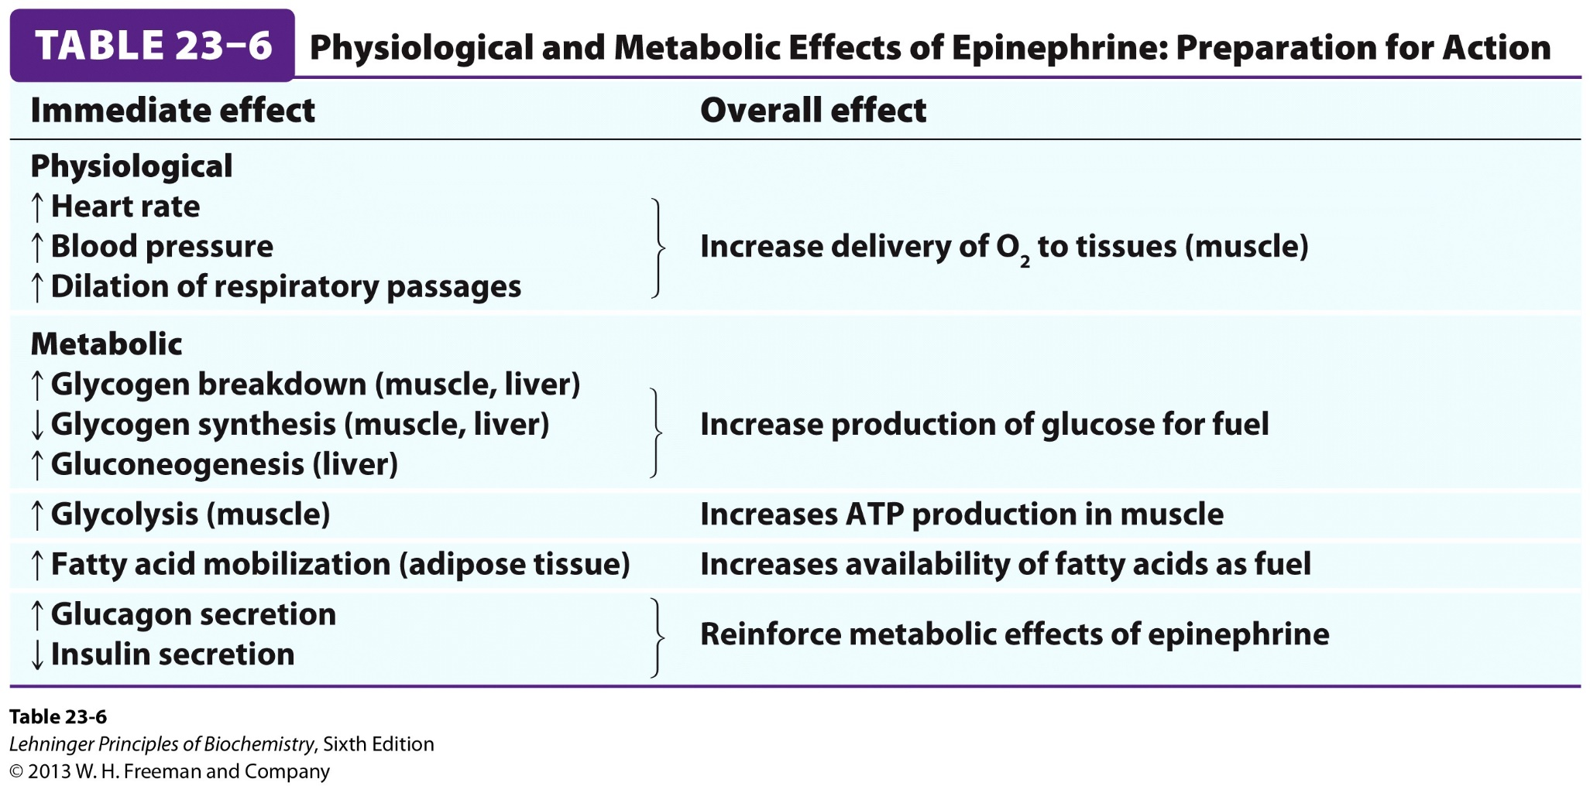
Metabolic effects of epinephrine, the fight-or-flight hormone

Slide 21
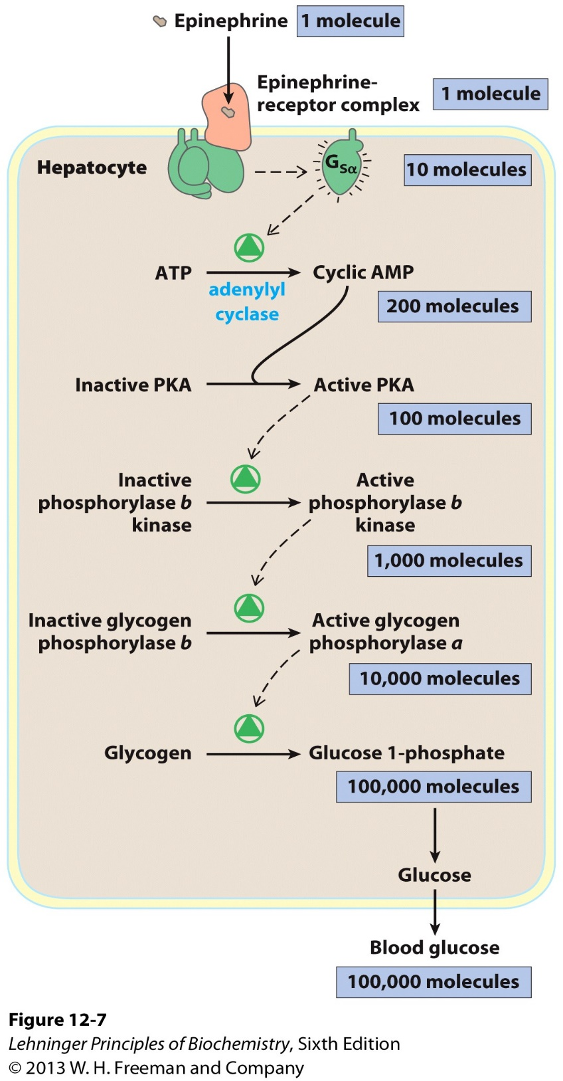
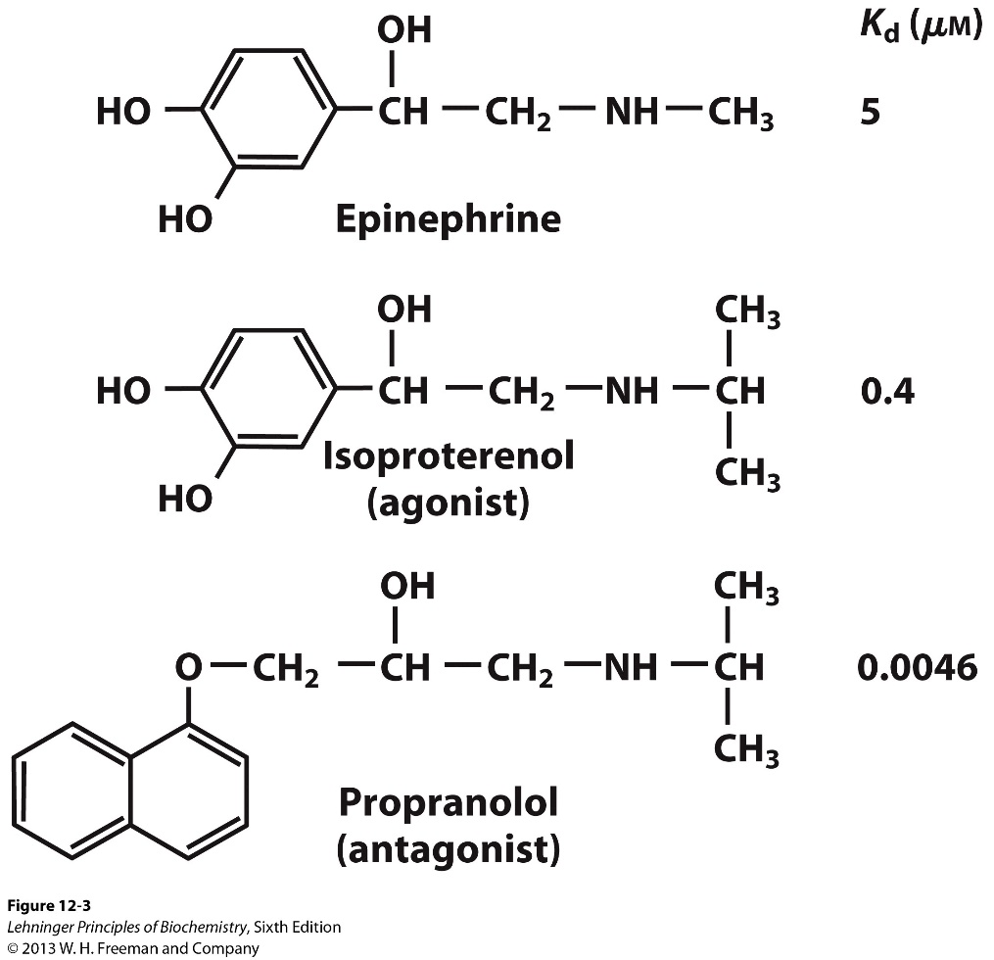
Molecular actions of epinephrine

Slide 22
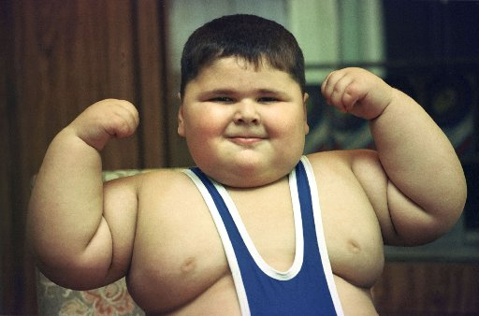
Outline of today’s discussion
Fasting vs fed
Lean vs obese
Healthy vs diabetic
Molecular genetics of metabolism

Slide 23
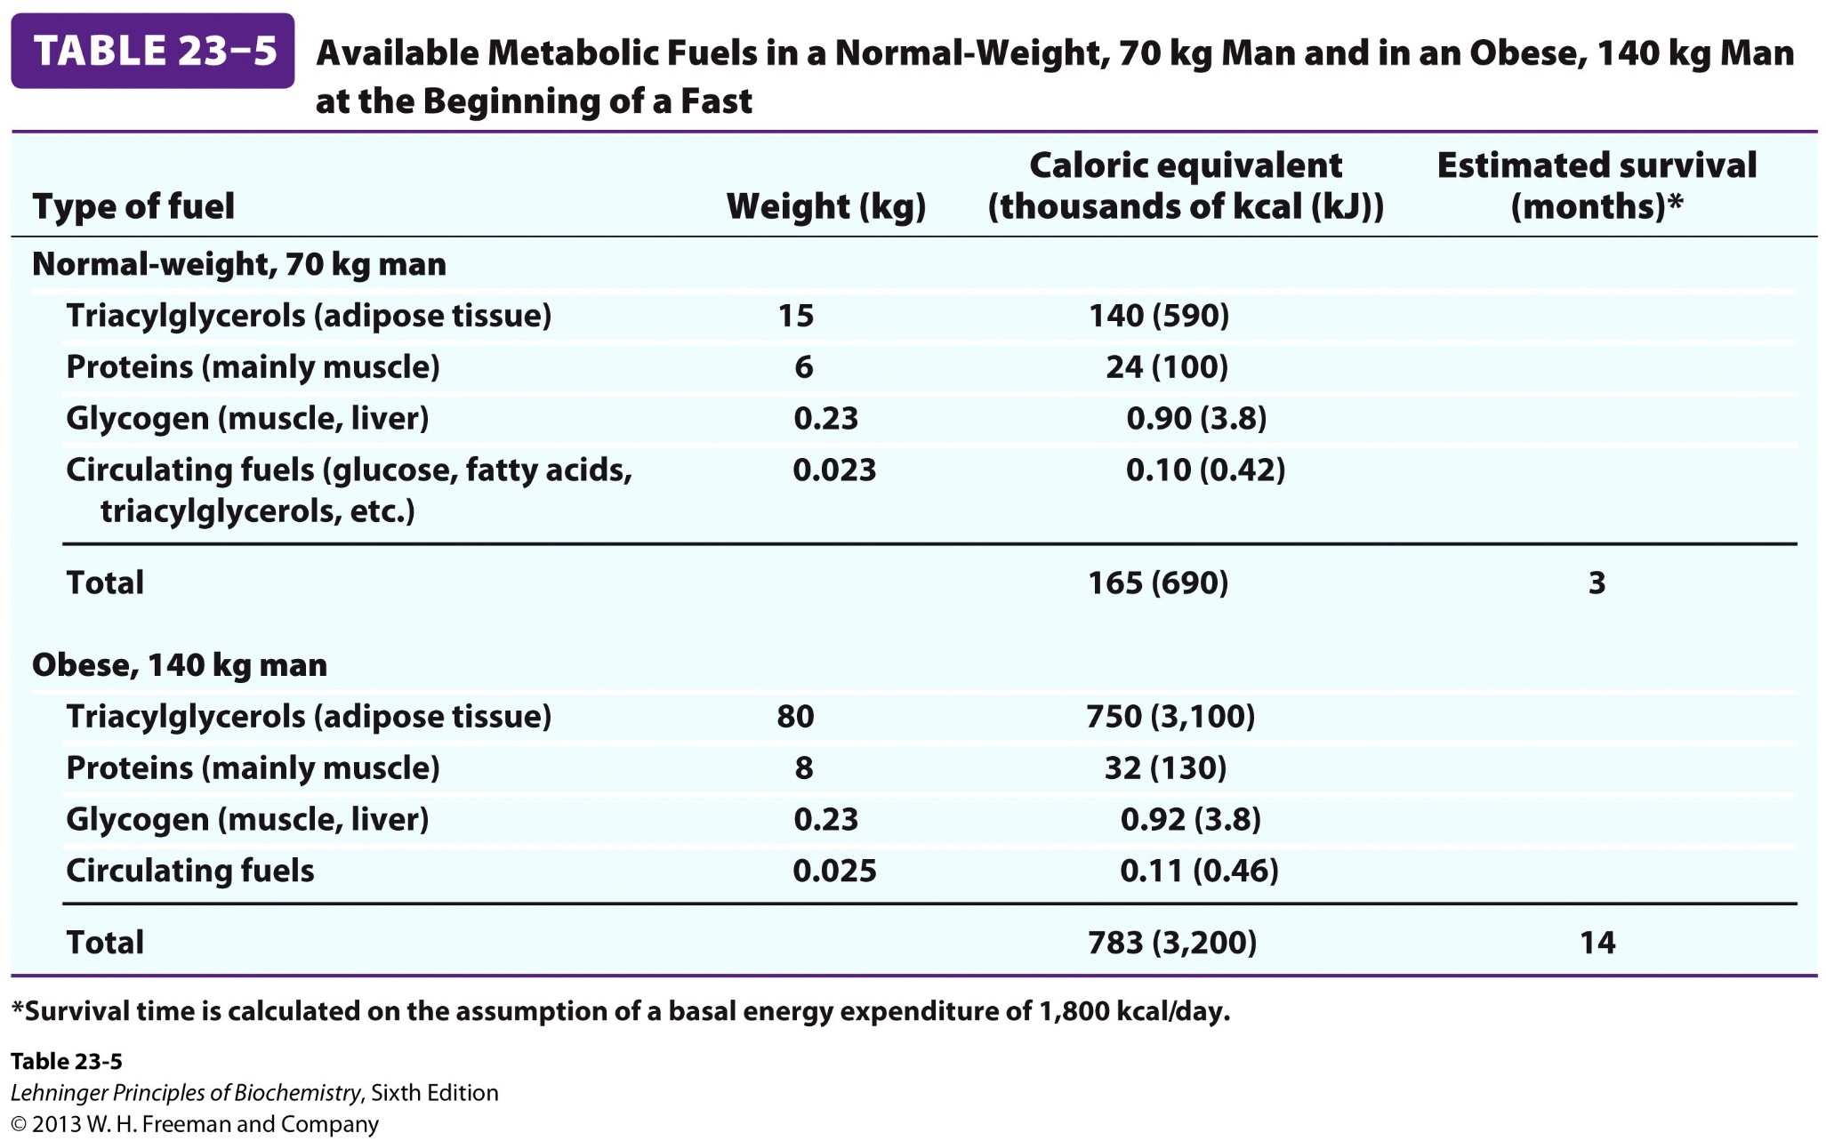

Slide 24
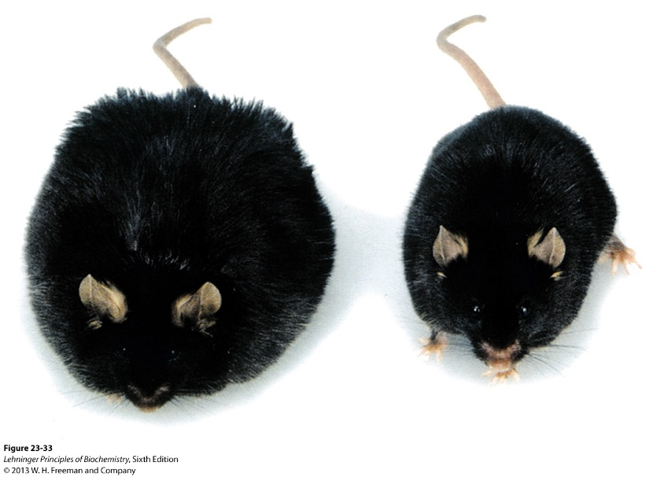
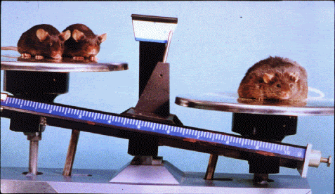
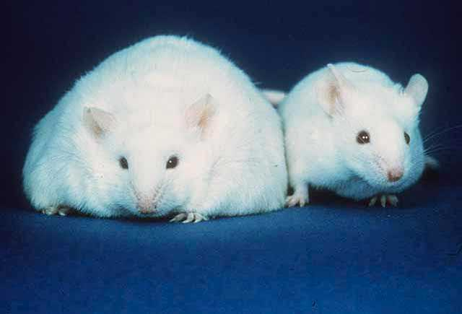
Genetics of obesity: ob/ob and db/db mice
ob/ob
db/db

Slide 25
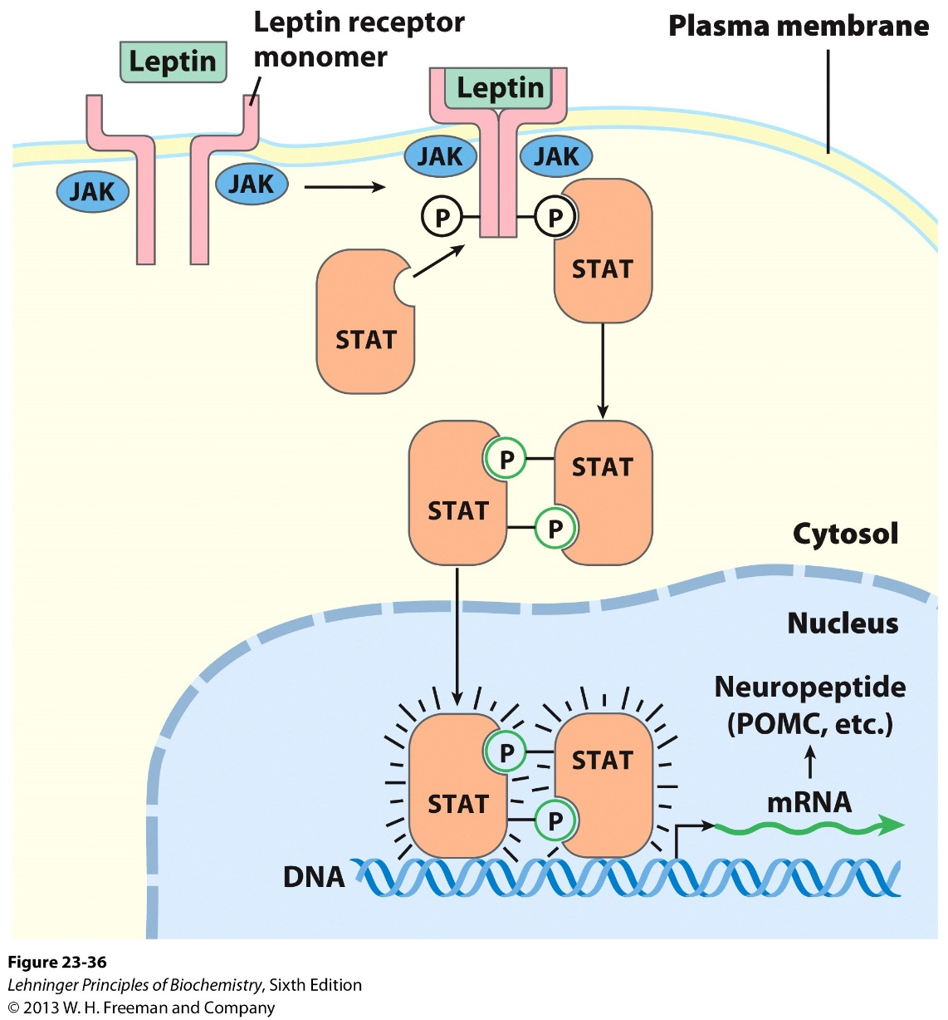
Genetics of obesity: ob/ob and db/db mice
Leptin and leptin receptor
ob/ob: mutation in the leptin gene (encodes a hormone)
db/db: mutation in the leptin receptor.
Leptin/Leptin receptor activates intracellular signaling through JAK/STAT

Slide 26
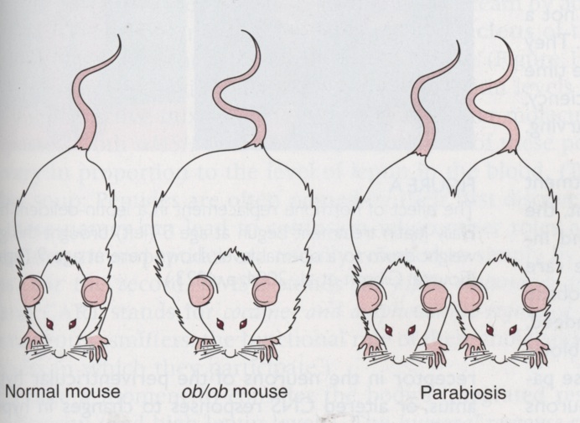
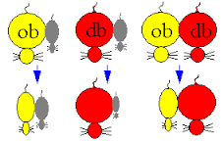
Genetics of obesity: parabiosis (连体实验） experiments
Key genetic concept: the function of the upstream gene is dependent on the downstream gene (epistasis)

Slide 27
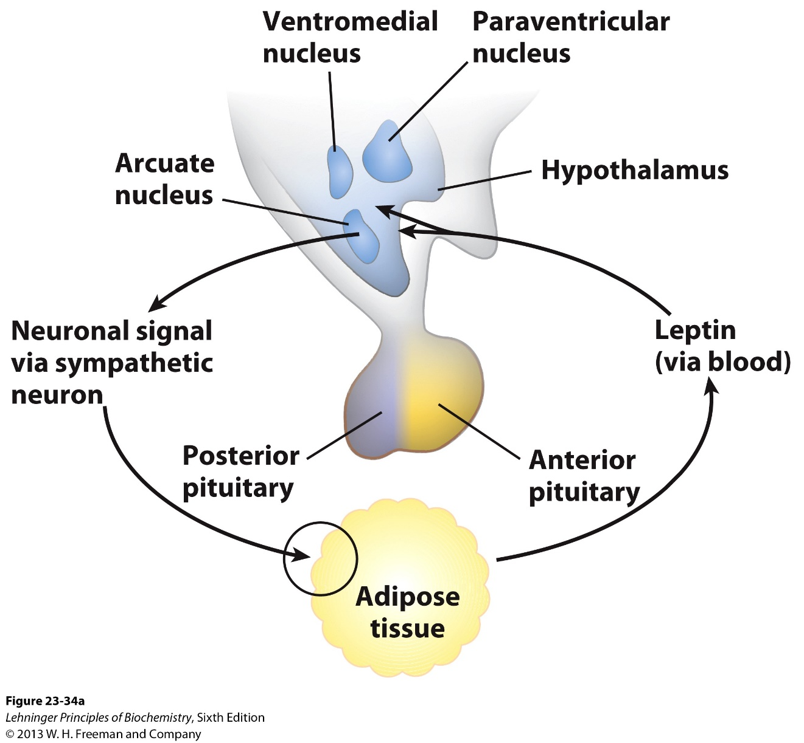
Biology of leptin: a hormone from periphery to regulate brain

Slide 28

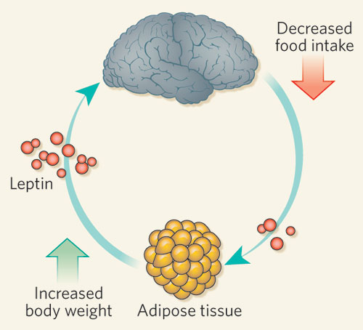

Leptin function: from “obese gene” to the lean factor (Lepto in Greek means thin/lean)

Slide 29
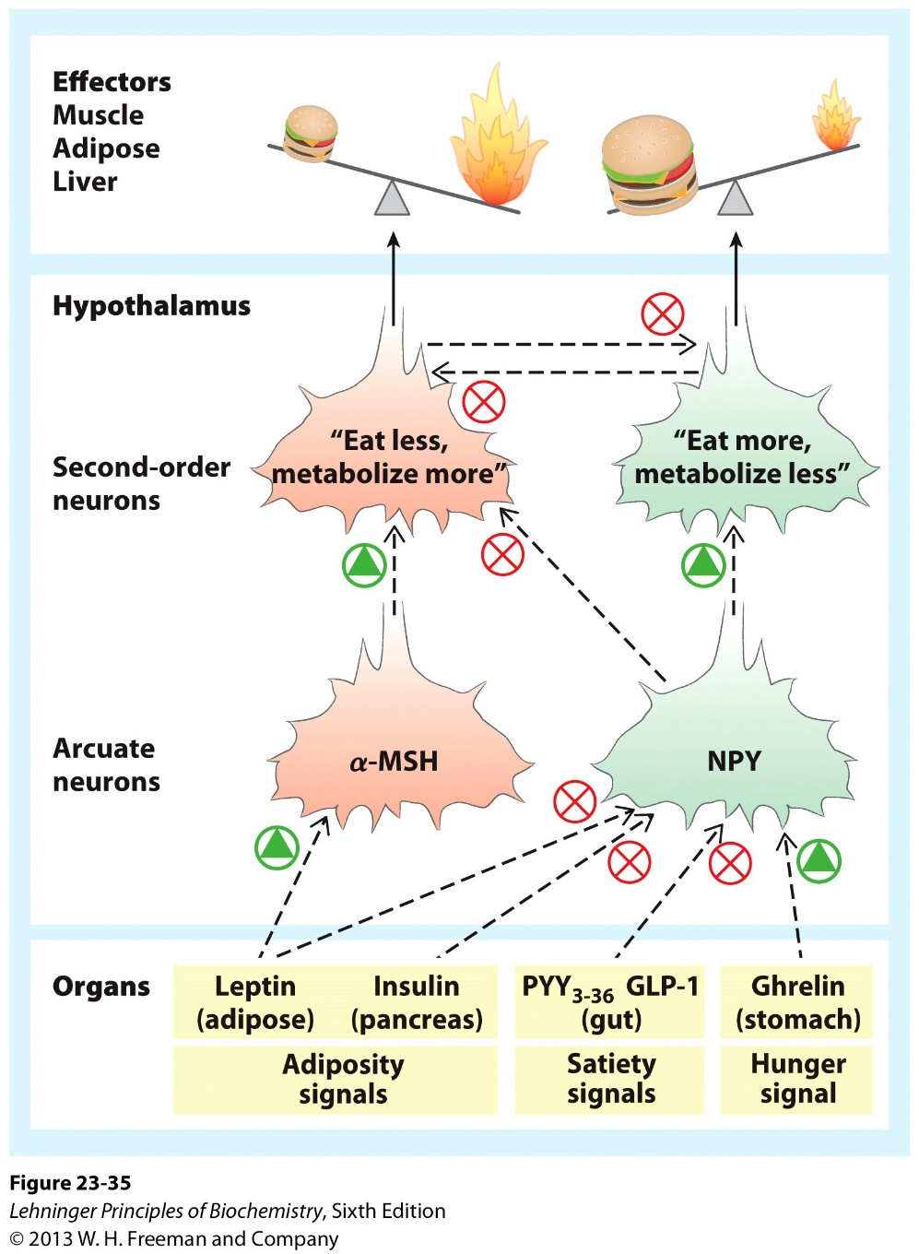
Leptin function: the satiety hormone

Slide 30
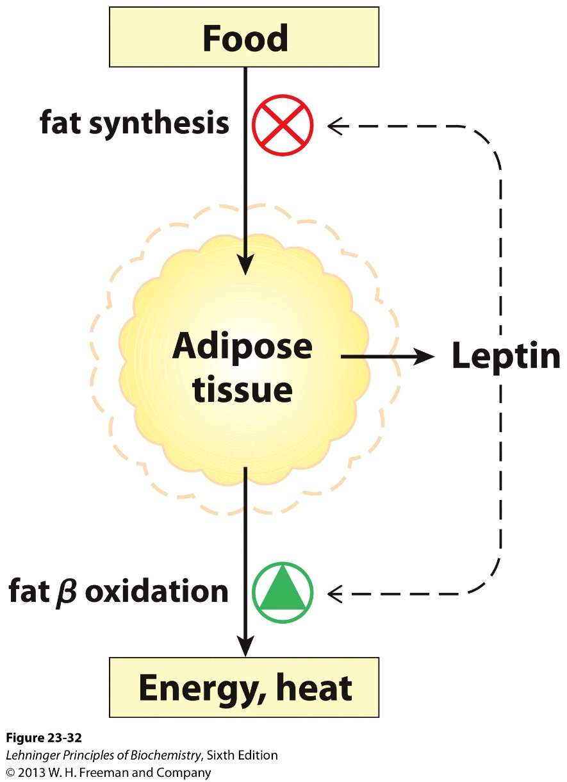
Other function of Leptin: negative feedback regulation of energy storage

Slide 31
Outline of today’s discussion
Fasting vs fed
Lean vs obese
Healthy vs diabetic
Molecular genetics of metabolism

Slide 32
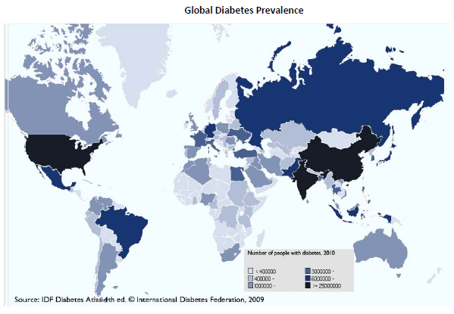

Slide 33
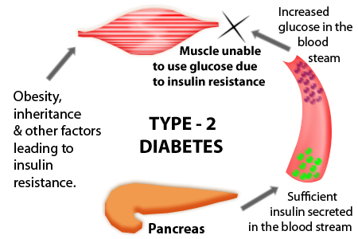
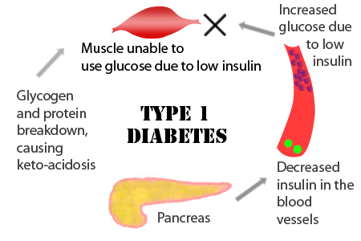
Two types of diabetes
Diabetes results from either deficiency in insulin production (Type 1) or failure in insulin action (Type 2), both cause uncontrolled blood glucose levels.

Slide 34
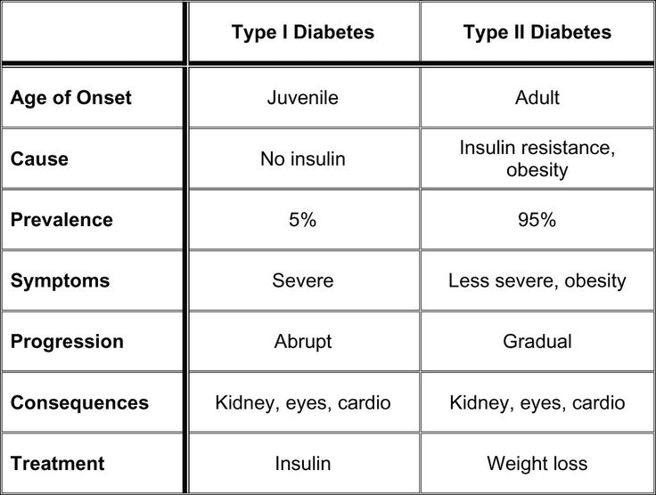
Comparison between Type 1 and Type 2 diabetes

Slide 35
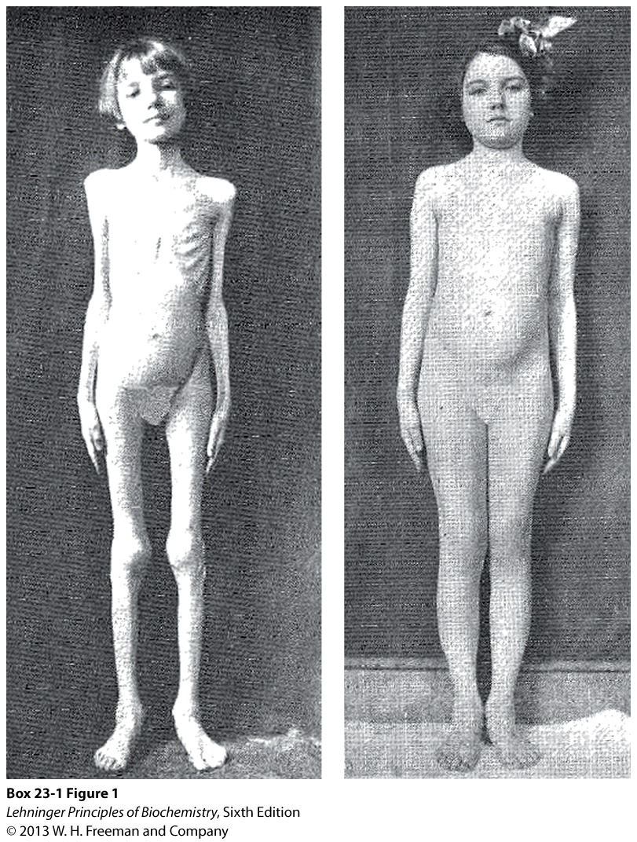
Treating Type 1 diabetes with insulin injection

Slide 36
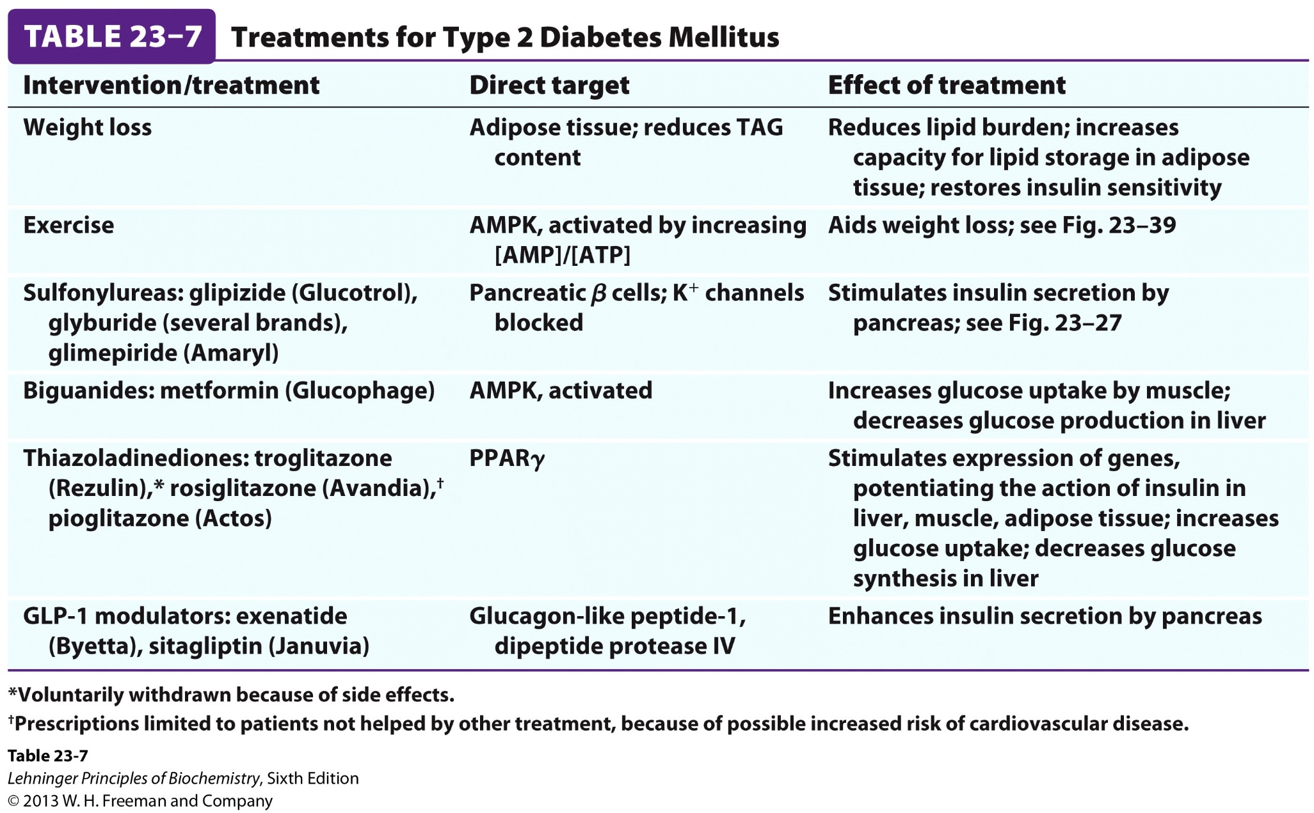

Slide 37
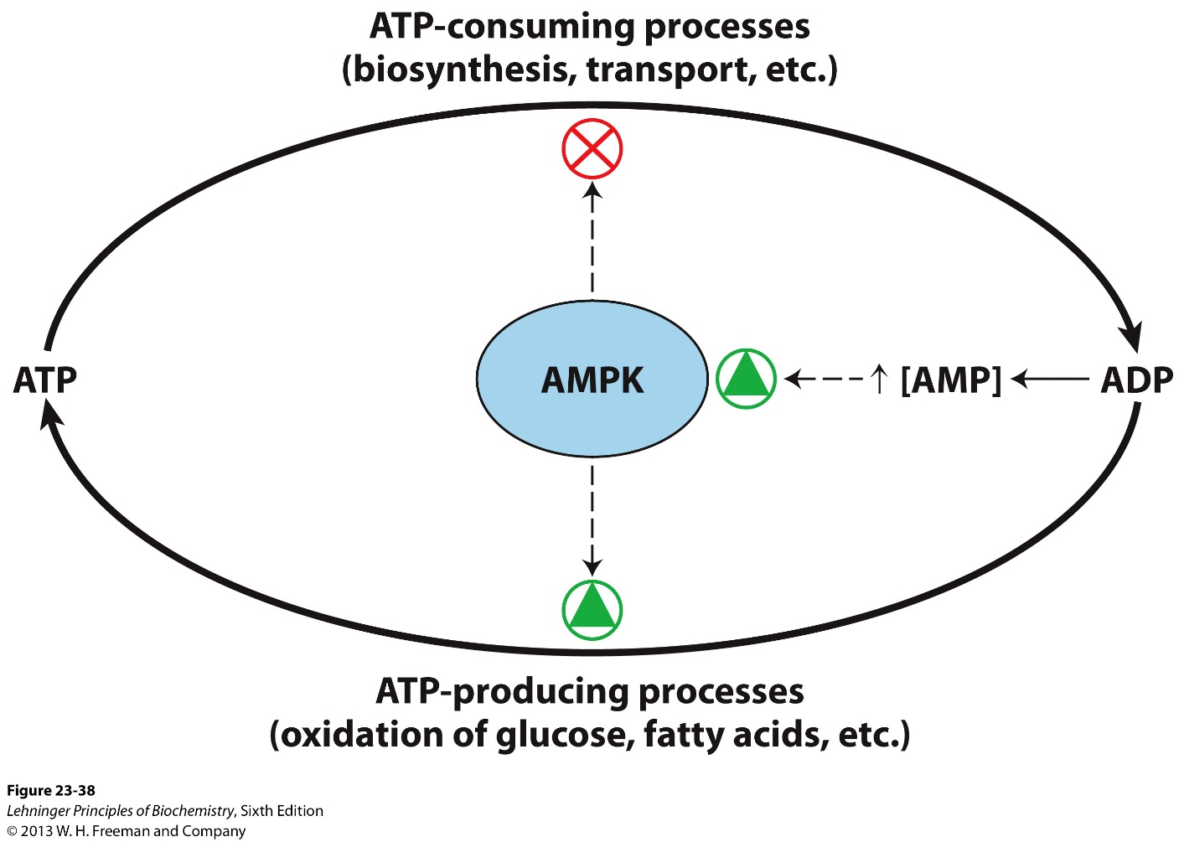
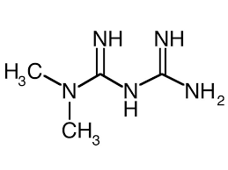
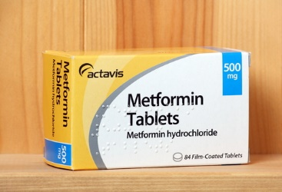
Activation of AMPK, a central energy sensor in cells

Slide 38
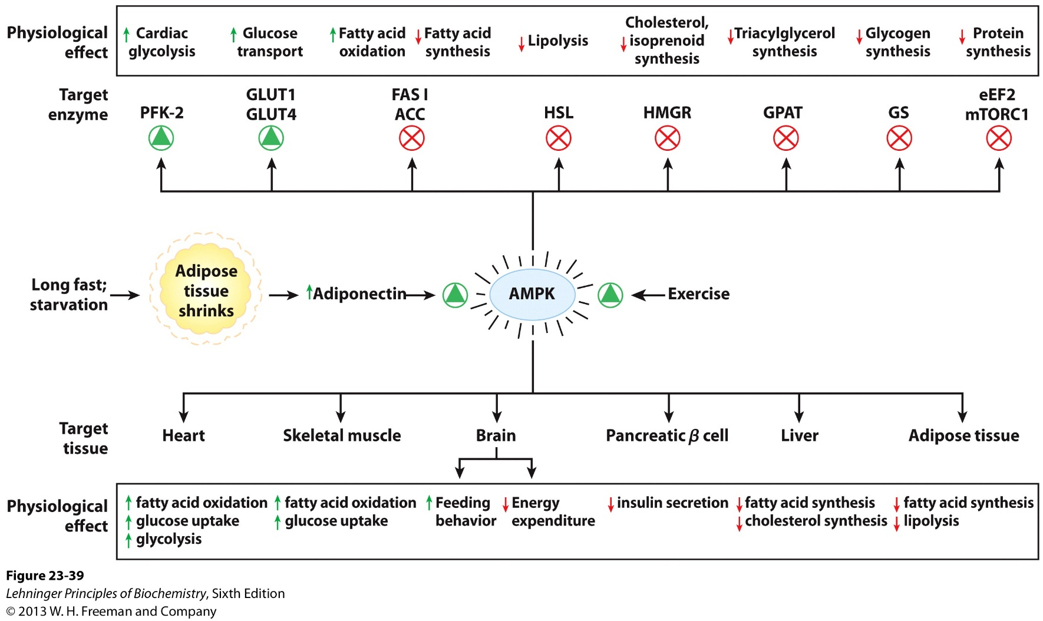
Metabolic effects of AMPK, a central energy sensor in cells

Slide 39
Outline of today’s discussion
Fasted vs fed
Lean vs obese
Healthy vs diabetic
Molecular genetics of metabolism

Slide 40

Search for inhibitors of HMG-CoA reductase
Akira Endo, hypothesized that antibiotics from fungi may kill parasites by inhibiting their cholesterol synthesis.
He used incorporation of [¹⁴C]acetate into nonsaponifiable lipids, searched for inhibitors among thousands of fungi culture broths.

Slide 41

Inhibitors of HMG-CoA reductase
Q: what happens to HMG-CoA reductase in cells when treated with compactin? HMG-CoA reductase increases dramatically, why?

Slide 42

Cholesterol inhibits the transcription factor SREBP (feedback loop)
Statins activates SREBP and expression of HMG-CoA reductase
SREBP
Cholesterol

Slide 43


Cells also obtain cholesterol from receptor-mediated endocytosis (of lipoproteins)

Slide 44
Regulation of cholesterol metabolism 3 dominant genes in humans
PCSK9
Plasma
ApoB
PCSK9
LDL Receptor
ApoB
PCSK9
Cholesterol Uptake
LDLR recycling
PCSK9
LDLR
Cholesterol
PCSK9 antibody
LDLR degradation

Slide 45





Cholesterol research and medicine
2008 Lasker Award
Statin drugs
1985 Nobel Prize
2016 Breakthrough Prize
Latest Blockbuster medicine

Slide 46
Science is a never ending journey
ApoB
?
A receptor to get in,
a receptor to get out?
ApoB

Slide 47



一只“良心发现”的小鼠
HFD
Ldlr ^{-/-}
Ldlr ^{-/-}, Surf4 LKO

Slide 48


Slide 49

is hard but could be beautiful.

Slide 50



Slide 51

Good luck with the finals and beyond!
Happy studying and stay hungry ☺

